Slide 1
EOEX Academy
Sicolo School of Code
Java Programming 101
(GUI Programming)

Slide 2
Table of Contents
Resources
Pre-Requisites
Concepts
  Jframe
  JtextField
  Jbutton
  JscrollBar
  Jmenu
  Dynamic List
  Jlabel
  JComboBox
Applied Concepts
  GUI Chat Frame
  GUI Calculator
  GUI Menu
  GUI Guessing Game
Mini Project
  TicTacToe
Next Class
Literarture
Thank you !

Slide 3
Resources
Personal Computer
Operating System (Linux recommended)
JDK (7+)
VSCode

Slide 4
Pre-Requisites
Knowledge of:
  Computer Technology
  Programming basics (variables, functions, loops, conditions, libraries, etc..)
  OOP concepts (Class, Object, Instance, Access modifiers, instance variables, instance methods)
  Computer file system organization
  Backup storage

Slide 5
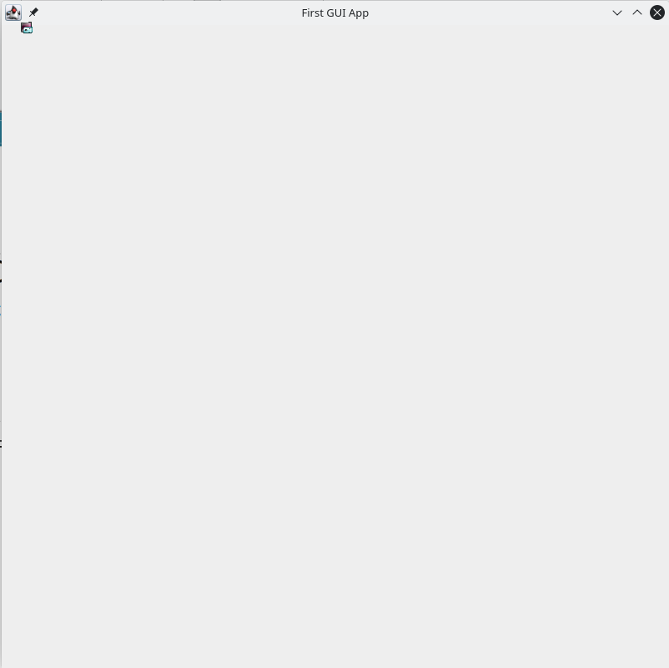
Concept 1: JFrame
Creates the main GUI app container
JFrame a = new JFrame("First GUI App");
a.setSize(800,800);
a.setLayout(null);
a.setVisible(true);

Slide 6
Concept 2: JTextField
Creates an instance of an object component of the GUI app: Text Field
JTextField b = new JTextField("edureka");
b.setBounds(50,20,200,30);

Slide 7
Concept 3: JButton
Creates an instance of an object component of the GUI app: Button
JButton c = new JButton("click me");
c.setBounds(50,60,200,30);

Slide 8
Concept 4: JScrollBar
Creates an instance of an object component of the GUI app: Button
JScrollBar d = new JScrollBar();
d.setBounds(50,120,40,90);

Slide 9
Concept 5: JMenu
Creates an instance of an object component of the GUI app: Menu
JMenuBar m1 = new JmenuBar();JMenu menu = new Jmenu("options");
                JMenuItem a1 = new JMenuItem("example");
        JMenuItem a2 = new JMenuItem("example1");
        menu.add(a1);
        menu.add(a2);
  m1.add(menu);

Slide 10
Concept 6: Dynamic List
Creates an instance of an object component of the GUI app: List
DefaultListModel<String> l = new DefaultListModel< >();
l.addElement("first item");
l.addElement("second item");
JList<String> e = new JList< >(l);
e.setBounds(50,300,75,75);

Slide 11
Concept 7: JLabel
Creates an instance of an object component of the GUI app: Label
JLabel b1 = new JLabel("edureka");
b1.setBounds(50,400,90,20);

Slide 12
Concept 8: JComboBox
Creates an instance of an object component of the GUI app: ComboBox
String courses[] = { "core java","advance java", "java servlet"};
JComboBox f = new JComboBox(courses);
f.setBounds(50,500,90,20);

Slide 13
Concept A: GUI Chat Frame
Create a GUI component using a combination of various sub-components: GUI Chat Frame
GUIChatFrame MyChatFrame = new GUIChatFrame();
MyChatFrame.initChatFrame();

Slide 14
Concept B: GUI Calculator
Create a GUI component using a combination of various sub-components: GUI Calculator
GUICalculator MyGUICalculator = new GUICalculator();
MyGUICalculator.launchCalculator();

Slide 15
Concept C: GUI Menu
Create a GUI component using a combination of various sub-components: GUI Menu
GUIMenu MyGUIMenu = new GUIMenu();
MyGUIMenu.launchGUIMenu();

Slide 16
Concept D: GUI Game
Create a GUI component using a combination of various sub-components: GUI Game
GUIGame MyGUIGame = new GUIGame();
MyGUIGame.launchGUIGame();

Slide 17
NEXT CLASS: Put it all together !
In the next class we will build a single application which contains all of the modules covered in this class.
Your homework is to review all of the code and start thinking about how you would do it :-)
Good Luck !

Slide 18




Recommended Literature
A Comprehensive Guide to
Java GUI Programming with SQLite
A Java GUI Programmer's Primer
Learn Java GUI Applications
JavaFX For Dummies

